Slide 1
University of Luxembourg
Introduction to the COBRA Toolbox
Advanced Systems Biology II
Multilingual. Personalised. Connected.
Systems Biology group-DLSM

Slide 2
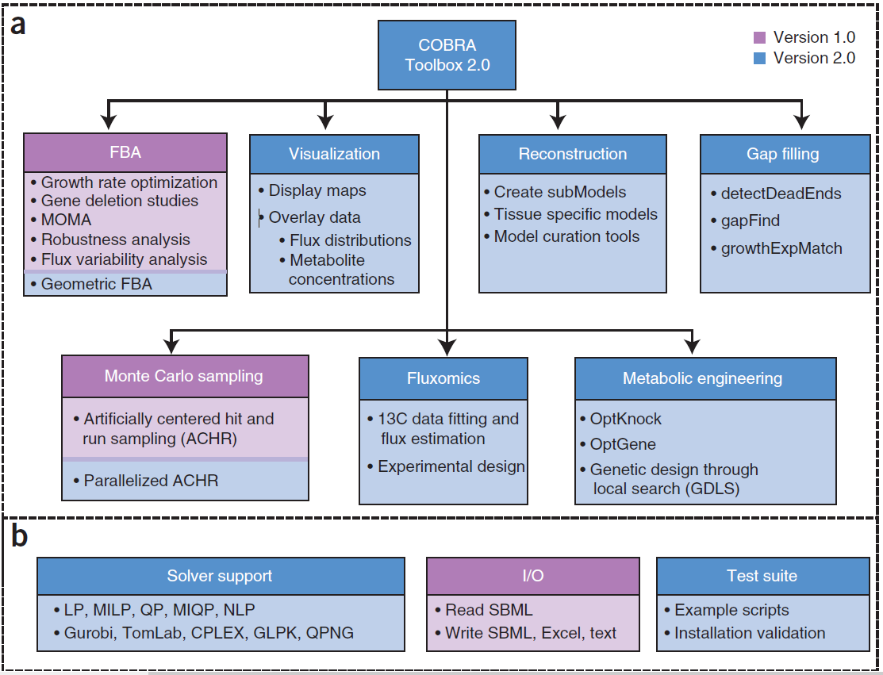
COBRA toolbox
COnstraint-Based Reconstruction and Analysis (COBRA) Toolbox
MATLAB software suite for quantitative prediction of cellular and multicellular biochemical networks using constraint-based modelling.
Methods
Model reconstruction and generation
Simulation
Analysis
Prediction of metabolic phenotypes
of genome-scale models
Strain design
Visualisation
Heirendt et al., 2019

Slide 3
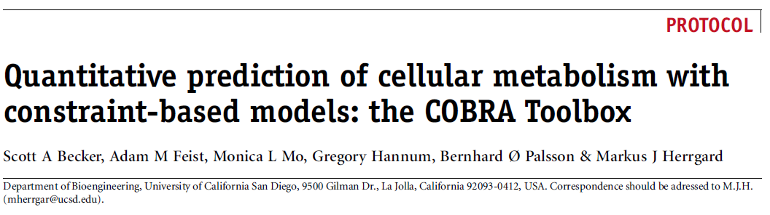
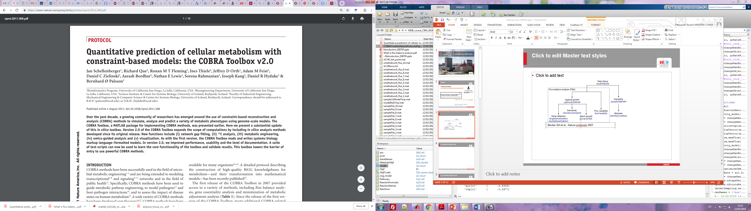
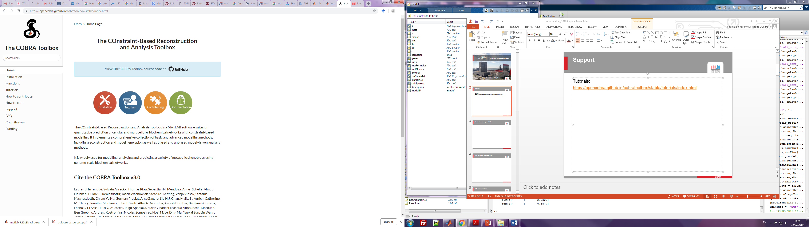
COBRA toolbox
New COBRA Toolbox v3.0:
Tutorials & Documentation
https://opencobra.github.io/cobratoolbox/stable/tutorials/index.html
Laurent Heirendt & Sylvain Arreckx et al. 2018

Slide 4
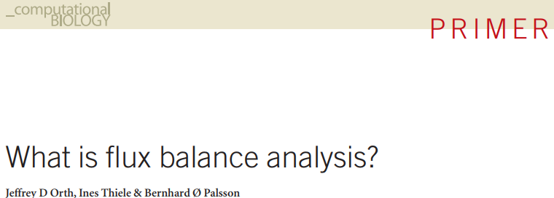
COBRA toolbox
Laurent Heirendt & Sylvain Arreckx et al. 2018

Slide 5
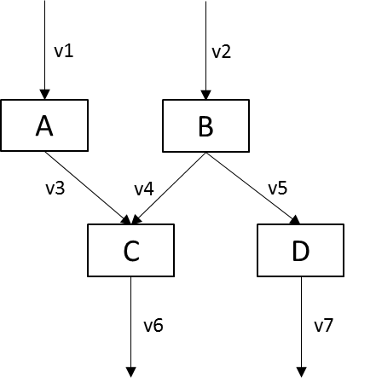
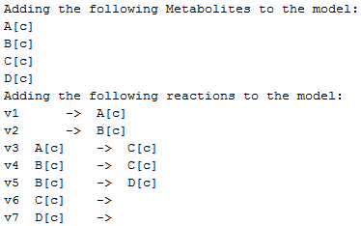
Create a model
ReactionFormulas = {'-> A',' -> B','A -> C','B -> C','B -> D','C ->','D ->'};
ReactionNames = {'v1','v2','v3','v4','v5','v6','v7'};
GeneNames={'Gene1','Gene2','Gene3','Gene4','Gene5','Gene6','Gene7'};
orig_model = createModel(ReactionNames, ReactionNames, ReactionFormulas,'grRuleList',GeneNames);

Slide 6
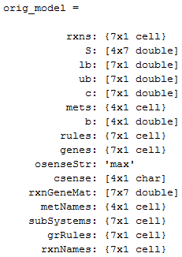
Check the structure of a model
Reactions
Stoichiometric matrix (mets ∙ rxns)
Lower bound
Upper bound
Weights of each flux in objective function
Metabolites
Change of metabolites at steady state => 0
Gene-protein-reaction (GPR) rules with gene indexes
Genes
Maximization of objective function
Constraints sense
Reaction gene matrix (rxns ∙ genes)
Metabolite names
Subsystems = pathways
Gene-protein-reaction (GPR) rules with gene names
Reaction names

Slide 7
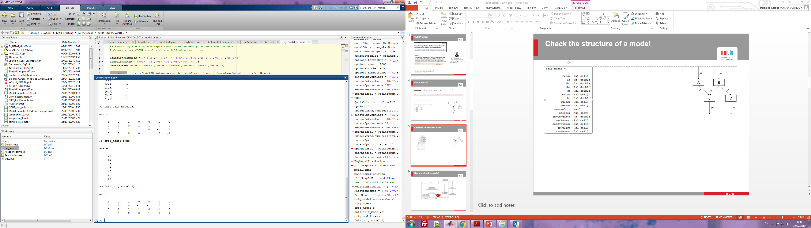
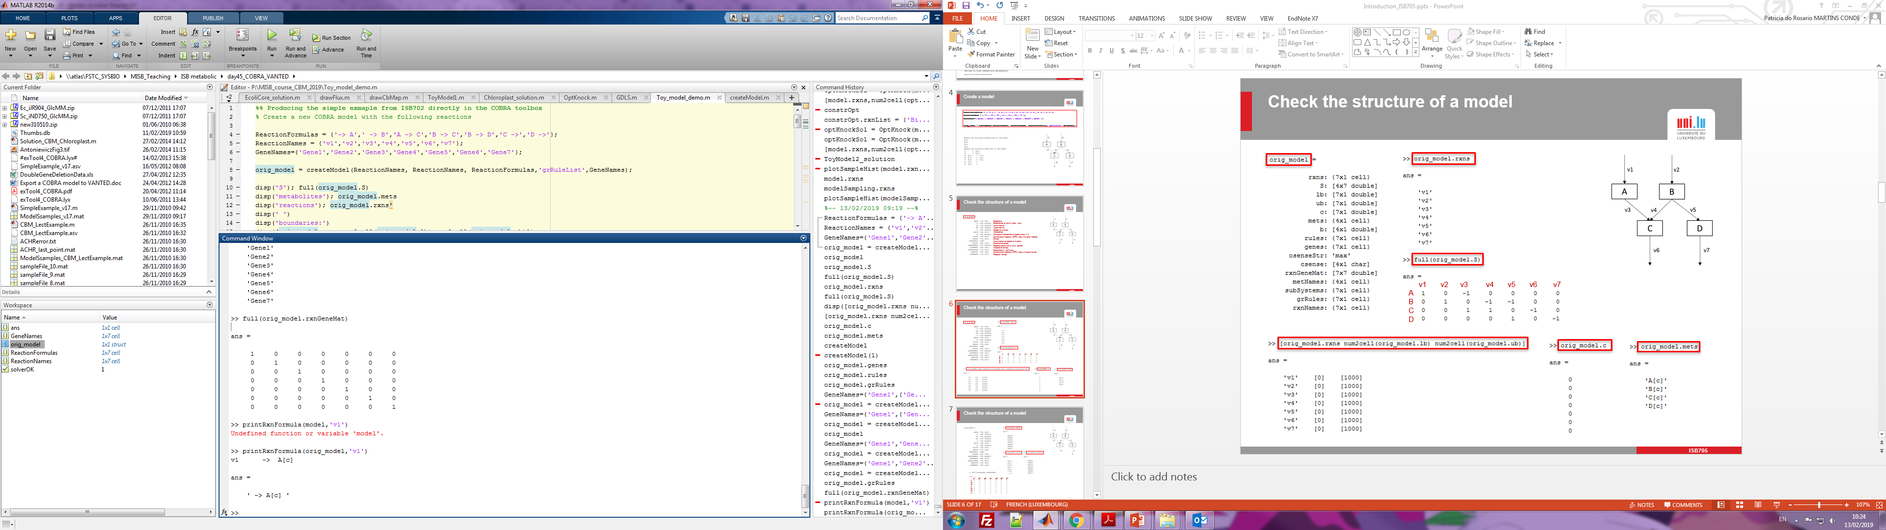
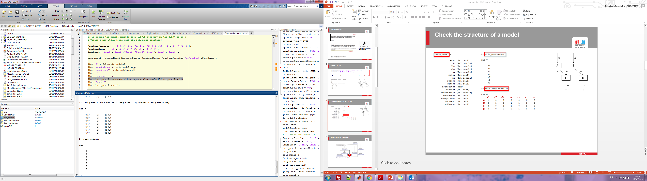
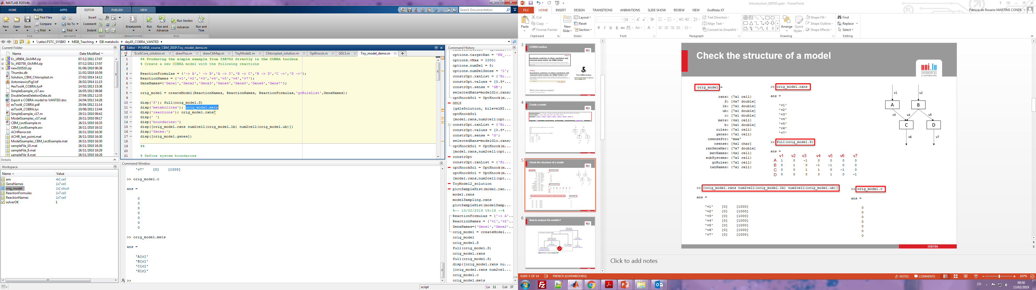
Check the structure of a model
v1 v2 v3 v4 v5 v6 v7
A
B
C
D

Slide 8
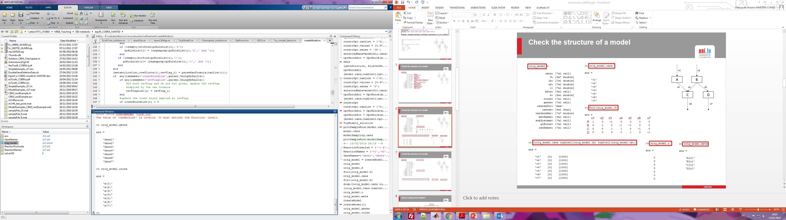
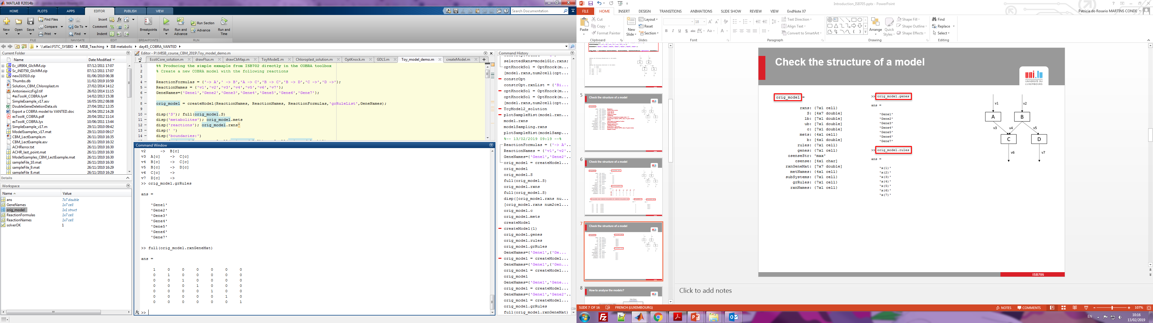
Check the structure of a model
g1 g2 g3 g4 g5 g6 g7
v1
v2
v3
v4
v5
v6
v7

Slide 9
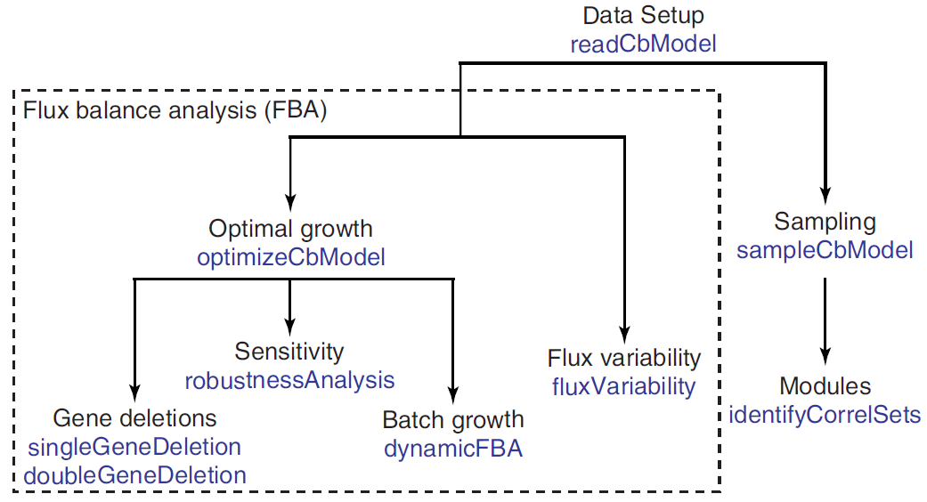
How to analyse the models?
Becker SA et al., Nature protocols 2007

Slide 10
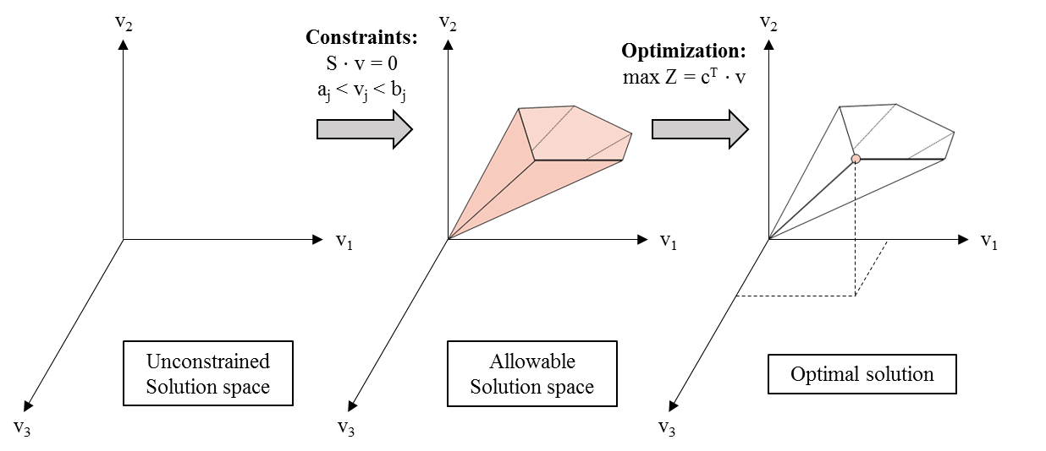
Flux balance analysis (FBA)
“FBA can thus be defined as the use of linear programming to solve the equation S∙v = 0 given a set of upper and lower bounds on v and a linear combination of fluxes as an objective function. The output of FBA is a particular flux distribution, v, which maximizes or minimizes the objective function.”
Orth et al. Nature Biotechnol, 2010
But usually not unique

Slide 11
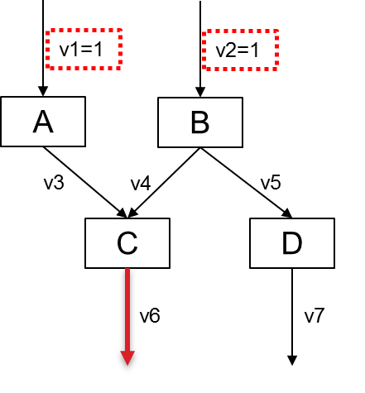
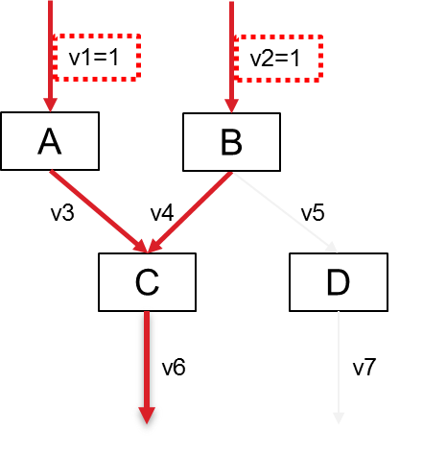
Flux balance analysis (FBA)
S ∙ v = 0
v1 v2 v3 v4 v5 v6 v7
A
B
C
D
.
= 0
Under steady state assumption
v1 – v3 = 0
v2 – v4 – v5 = 0
v3 + v4 – v6 = 0
v5 –v7 = 0
v1 = v3
v4 = v2 – v5
v6 = v3 + v4
v5 = v7
Constraints:
v1 = 1
v2 = 1
v3, v4, v5, v6, v7 ≥ 0
v3 = 1
v4 = 1 – v5
v6 = 1+ v4
v5 = v7
v3 = 1
v4 = 1 – v5
v6 = 1 + 1 – v5
v5 = v7
v3 = 1
v4 = 1 – v5
v6 = 2 – v5
v5 = v7
Max v6
v1 = 1
v2 = 1
v3 = 1
v4 = 1
v6 = 2
v5 = 0
v7 = 0
v5 ≥ 0

Slide 12
v1=1
v2=1
v1=1
v2=1
A
B
A
B
v3
v4
v5
v3
v4
v5
C
D
C
D
v6
v7
v6
v7

Slide 13
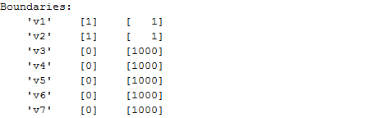
Flux balance analysis (FBA)
Select the solver
solverOK=changeCobraSolver('ibm_cplex');
Constraint the model
model=orig_model;
model = changeRxnBounds(model,{'v1','v2'},[1 1],'b');
disp('Boundaries:')
disp([model.rxns num2cell(model.lb) num2cell(model.ub)])
v1=1
v2=1
A
B
v3
v4
v5
C
D
v6
v7

Slide 14
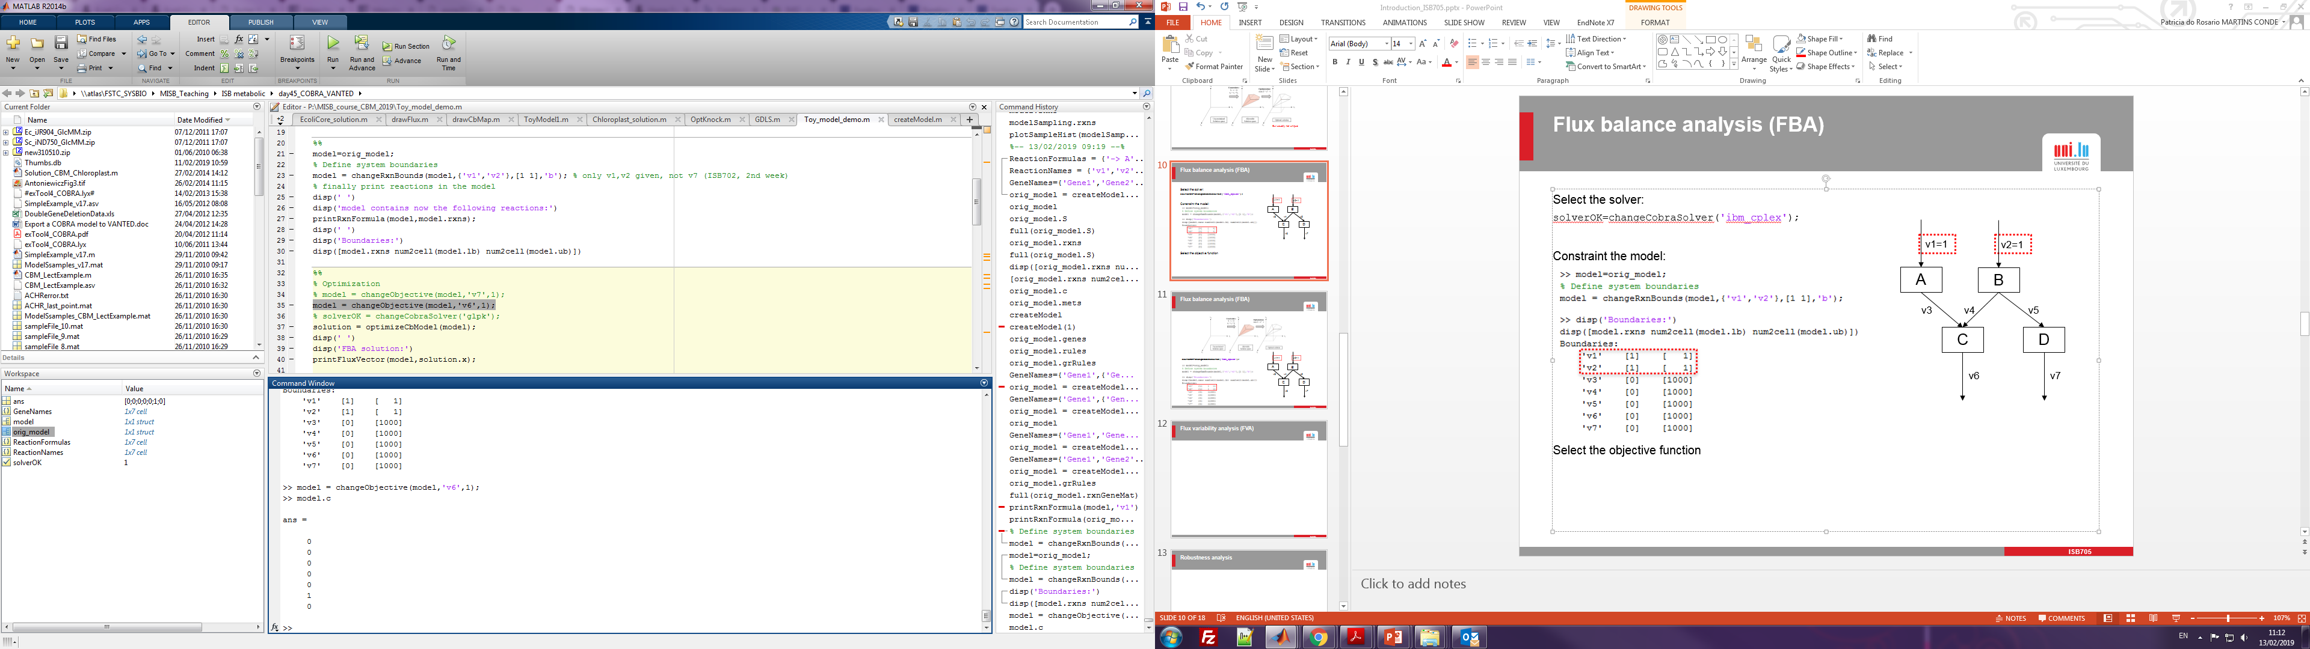
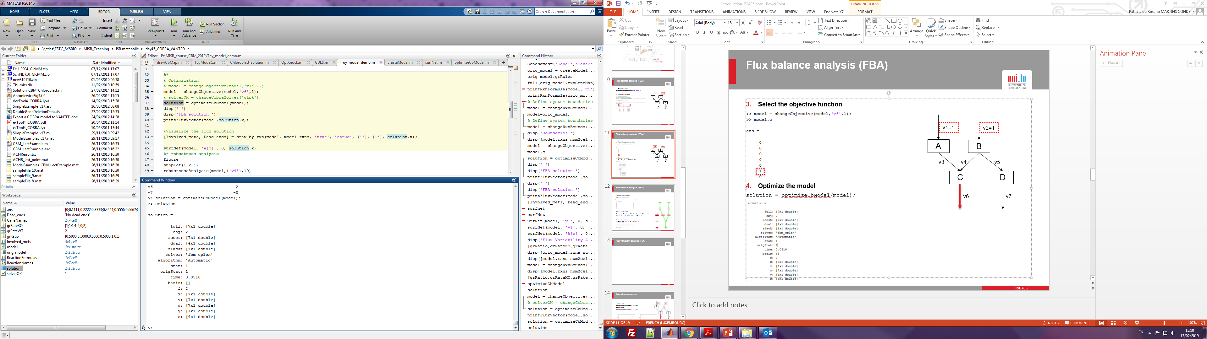
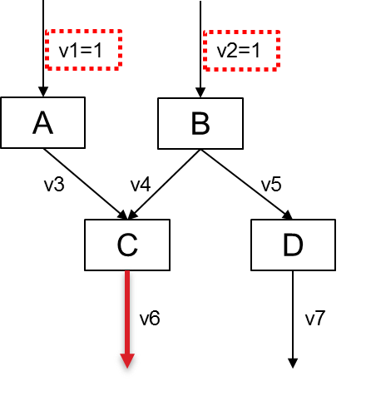
Flux balance analysis (FBA)
Set the objective function
model = changeObjective(model,'v6',1);
model.c
Optimize the model
solution = optimizeCbModel(model);
solution
Objective value
Solution status
Objective value
Flux distribution

Slide 15
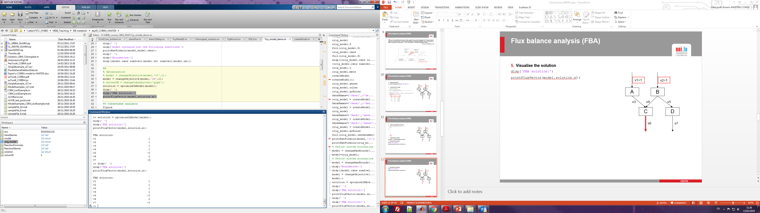
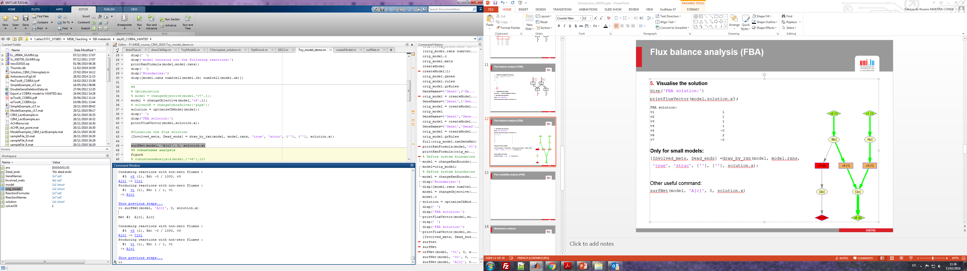
Flux balance analysis (FBA)
Visualise the solution
disp('FBA solution:')
printFluxVector(model,solution.x);
Only for small models:
[Involved_mets, Dead_ends] = draw_by_rxn(model, model.rxns,
'true', 'struc', {''}, {''}, solution.x);
Other useful and interactive command:
surfNet(model, 'A[c]', 0, solution.x)

Slide 16
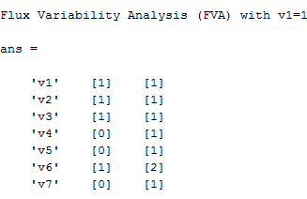
Flux variability analysis (FVA)
FVA allows the calculation of the full range of numerical values for each reaction flux in the network.
It is useful to determine the flux ranges corresponding to the optimal solution obtained through FBA.
model = changeObjective(model,'v6',0); %Remove the objective function to see how the fluxes vary in the model. Do not remove it for the exercises!
disp('Flux Variability Analysis (FVA) with v1=1')
[minFlux,maxFlux] = fluxVariability(model,100);
[model.rxns num2cell(minFlux) num2cell(maxFlux)]
v1=1
v2=1
A
B
v3=1
v4=[0-1]
v5=[0-1]
C
D
Variable fluxes
v6=[1-2]
v7=[0-1]

Slide 17

Robustness analysis
Robustness analysis allows the determination of how an objective of interest (e.g. growth rate, lactate production) changes as the flux through a specific reaction of interest varies in magnitude, thus, checking the network robustness with respect to the reaction of interest.
model = changeObjective(model,'v6',1);
figure
subplot(1,2,1)
robustnessAnalysis(model,{'v4'},10)
subplot(1,2,2)
robustnessAnalysis(model,{'v7'},10)

Slide 18
Simulation of gene knock outs
Easily simulated with in silico models
Dependent on the proper setup of the gene-reaction matrix and the boolean rules
Affected reactions by a gene deletion have bounds set to 0 → not functional
Single gene deletions or double gene deletions
Unchanged maximal growth
Reduced maximal growth
No growth (lethal)
Deletion studies can be used to predict gene/reaction essentiality and to prioritize target genes which can be validated experimentally.
Useful for strain design and drug targets prediction.

Slide 19
Simulation of gene knock outs
Importance of the proper setup of boolean rules
G1 knockout
No effect of gene deletion

Slide 20
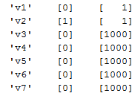
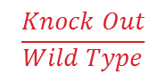
Single gene deletion
model = changeRxnBounds(model,{'v1'},[0],'l');
disp([model.rxns num2cell(model.lb) num2cell(model.ub)])
Single gene deletion
[grRatio,grRateKO,grRateWT] = singleGeneDeletion(model,'FBA')
0≤v1≤1
v2=1
A
B
$$\frac{Knock Out}{Wild Type}$$
Objective value in Knock Out
Objective value in Wild Type
v3
v4
v5
C
D
v6
v7

Slide 21
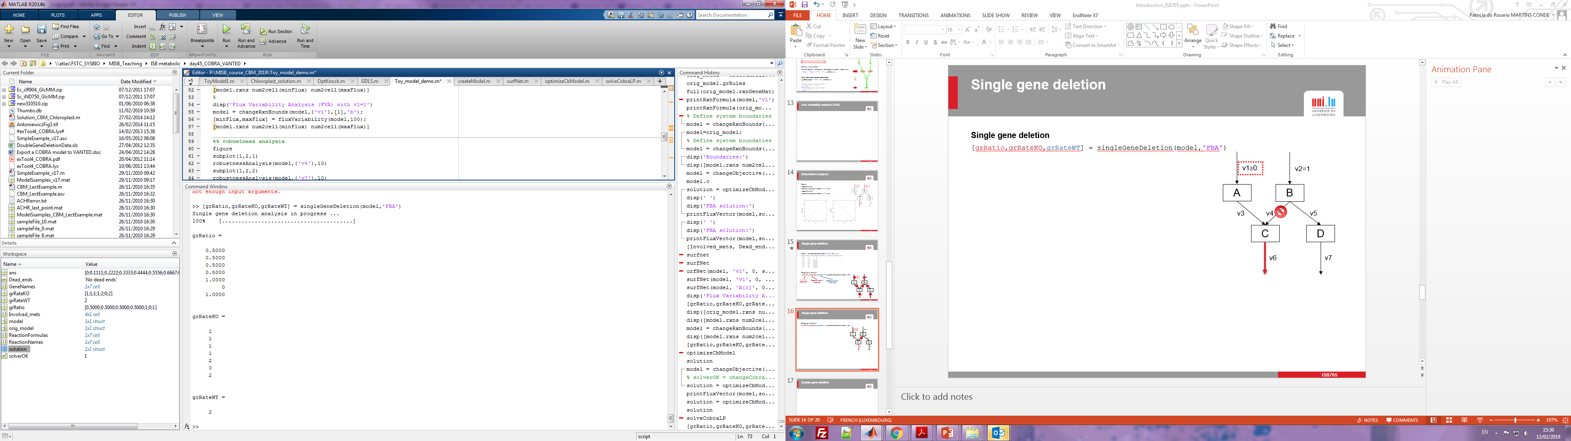
Single gene deletion
Single gene deletion
[grRatio,grRateKO,grRateWT] = singleGeneDeletion(model,'FBA')
0≤v1≤1
v2=1
Gene1
Gene2
Gene3
Gene4
Gene5
Gene6
Gene7
A
B
v3
v4
v5
C
D
No effect
v6
v7

Slide 22
Single gene deletion
Single gene deletion
[grRatio,grRateKO,grRateWT] = singleGeneDeletion(model,'FBA')
0≤v1≤1
v2=1
Gene1
Gene2
Gene3
Gene4
Gene5
Gene6
Gene7
A
B
Effect:
↘ Objective flux
v3
v4
v5
C
D
v6
v7

Slide 23
Single gene deletion
Single gene deletion
[grRatio,grRateKO,grRateWT] = singleGeneDeletion(model,'FBA')
0≤v1≤1
v2=1
Gene1
Gene2
Gene3
Gene4
Gene5
Gene6
Gene7
A
B
v3
v4
v5
C
D
Essential gene (lethal!)
v6
v7

Slide 24
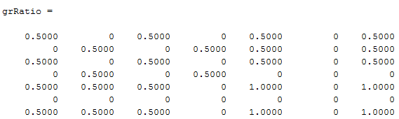
Double gene deletion
Double gene deletion
[grRatio,grRateKO,grRateWT] = doubleGeneDeletion(model,'FBA')
Gene1 Gene2 Gene3 Gene4 Gene5 Gene6 Gene7
Gene1
Gene2
Gene3
Gene4
Gene5
Gene6
Gene7
0≤v1≤1
v2=1
Essential gene (lethal!)
A
B
Lethal double gene deletions
Gene1-Gene2
Gene1-Gene4
Gene1-Gene6
Gene2-Gene3
Gene2-Gene6
Gene3-Gene4
Gene3-Gene6
Gene4-Gene5
Gene4-Gene6
Gene4-Gene7
Gene5-Gene6
Gene6-Gene7
v3
v4
v5
C
D
v6
v7

Slide 25
Sampling of the allowed flux distributions around the optimal solution
Sampling enables the characterization of all allowed flux distributions. The set of flux distributions obtained from sampling can be further interrogated, enabling to determine the most likely flux value through any reaction, given the model constraints, and to establish the dependency between two reactions in the network.
model = changeRxnBounds(model,{'v1','v2'},[1 1],'b');
model = changeRxnBounds(model,{'v6'},0.9*solution.f,'l');
Sampling options
options.nStepsPerPoint = 8 * size(model.S, 2);
options.nPointsReturned = 1000;
Sampling
[modelSampling,samples] = sampleCbModel(model,'sampleFile','ACHR', options);

Slide 26
Visualisation of the sampling results
Reaction flux correlation and fluxes distribution
sampleScatterMatrix({'v4','v5','v6','v7'},modelSampling,samples) %do not include the constant rates here
Reaction flux correlation
figure
for counter=1:size(samples,1)
for counter2=counter:size(samples,1)
subplot(size(samples,1),size(samples,1),(counter-1)*size(samples,1)+counter2)
plot(samples(counter,:),samples(counter2,:),'*')
xlabel(model.rxns(counter)),ylabel(model.rxns(counter2))
end
end
Fluxes distribution:
plotSampleHist(modelSampling.rxns, {samples}, modelSampling,[],[4,2]);

Slide 27
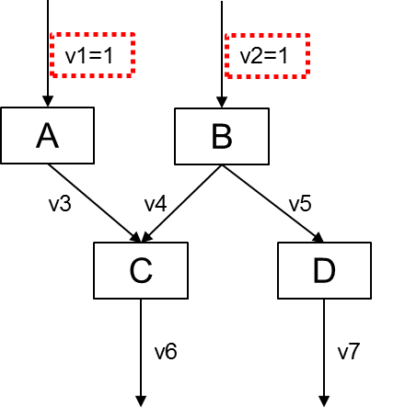
Visualisation of the sampling results
Reaction flux correlation and fluxes distribution
sampleScatterMatrix({'v4','v5','v6','v7'},modelSampling,samples) %do not include the constant rates here

Slide 28
Visualisation of the sampling results
Reaction flux correlation
figure
for counter=1:size(samples,1)
for counter2=counter:size(samples,1)
subplot(size(samples,1),size(samples,1),(counter-1)*size(samples,1)+counter2)
plot(samples(counter,:),samples(counter2,:),'*')
xlabel(model.rxns(counter)),ylabel(model.rxns(counter2))
end
end
No effect
Constant fluxes
Correlated reactions

Slide 29
Visualisation of the sampling results
Fluxes distribution:
plotSampleHist(modelSampling.rxns, {samples}, modelSampling,[],[4,2]);

Slide 30
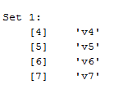
Identification of correlated reaction fluxes
Sampling enables the determination of dependencies between reactions that can be further used to identify sets of correlated reactions which have to be co-utilized in precise stoichiometric ratios.
[sets,setNumber,setSize]=identifyCorrelSets(modelSampling,samples,1-1e-8);
Visualise the sets of correlated reaction fluxes
for counter=1:size(sets)
temp=cell2mat(sets(counter));
disp(['Set ' num2str(counter) ':'])
disp([num2cell(temp.set) temp.names])
end
Constant fluxes are not detected (v1, v2 and v3)

Slide 31
Other useful commands
Basic COBRA functions:
addReaction add a new reaction to a model
changeObjective change the objective function reaction(s)
changeRxnBounds change the upper or lower bounds on reactions
deleteModelGenes constrain reactions associated with deleted genes to 0
drawFlux print a flux distribution on a map
findRxnIDs get index of a reaction
optimizeCbModel perform FBA on a model
printFluxVector print the results of an FBA calculation
printRxnFormula print the formula of a reaction
readCbModel (requires SBML Toolbox) load a model in SBML format
writeCbModel (requires SBML Toolbox) write a model in SBML format

Slide 32
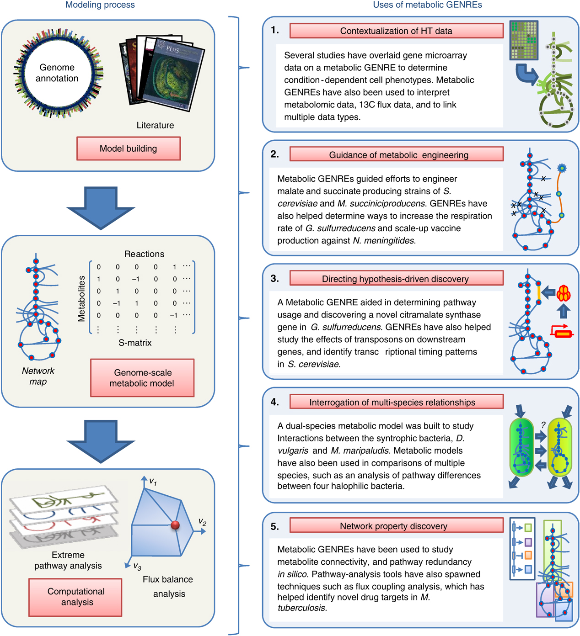
Applications
Facilitates the interpretation of omics results
Strain design
New hypothesis
Microbial communities
Host-pathogen interactions
Multi-tissues
Drug targets identification
Oberhardt et al., Molecular Systems Biology, 2009

Slide 33
Getting familiar with the COBRA Toolbox
Day 1
Toy model 1 3 metabolites & 5 reactions
Toy model 2 6 metabolites & 10 reactions
Day 2
Chloroplast carbon model 18 metabolites & 23 reactions
E. coli core model 72 metabolites & 95 reactions
↗ Model
Complexity

